Slide 1
Measure Factory User Guide
2017

Slide 2
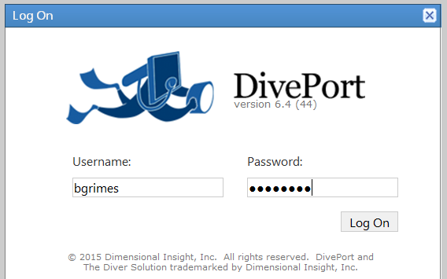
Login
Login and password- single signon for AD account

Slide 3
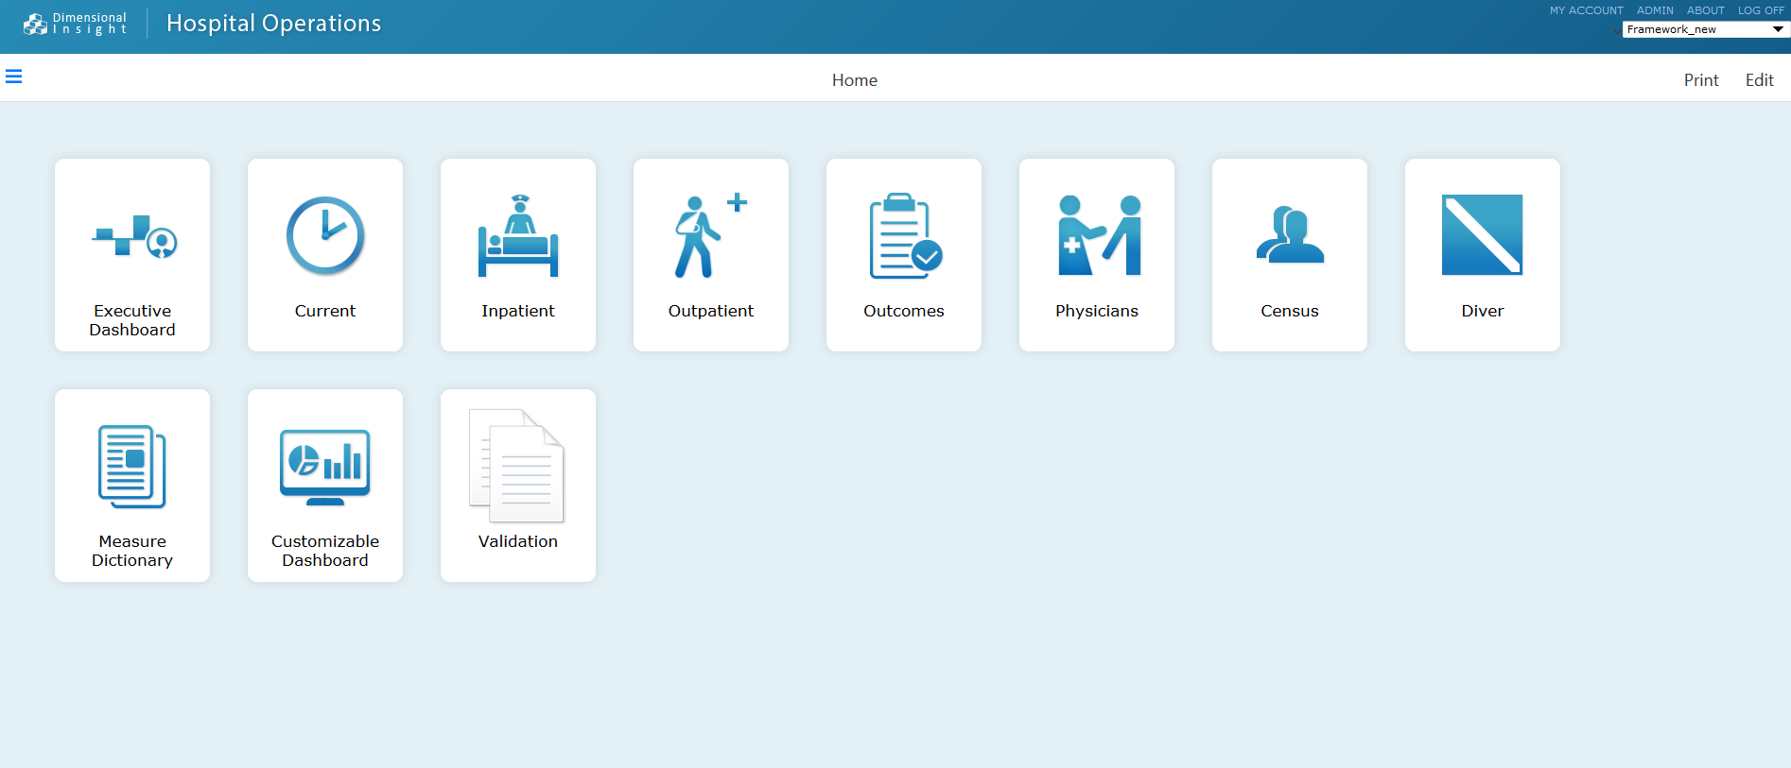
Dashboard Launch Screen
To access a dashboard:
Double click on the dashboard you want to open
Individually, you may not have access to all dashboards seen pictured here.

Slide 4
Dashboard Focus
Executive- provide current state and trending information for measures within Operational, Revenue, Quality, Efficiency
Inpatient- a current (daily) snapshot as well as monthly and yearly trended operational information as defined by key operational volume performance measures
Outpatient- a current (daily) snapshot as well as monthly and yearly trended operational information as defined by key operational volume performance measures
Current- to provide a high level view of current patient census volume by facility
Census- to provide a high level view of current patient census volume by facility and nursing unit as it compares to the unit capacity. Graphs are presented to provide leadership with a perspective on unit throughput by aggregating hourly census data along with unit admission, transfer, and discharge statistics. Census measures provide for both an hourly and midnight /daily timeframe along with comparison to the previous day.
Outcomes- reflects a summary of standard outcomes measures that have been specified by various regulatory, quality improvement and reimbursement programs.

Slide 5
Dashboard Focus Cont.
Physician- a high level perspective on physician volume and quality indicator statistics. Physician case volumes are reported by DRG, service, or specialty and subsequently trended over time.
Ad Hoc Analysis - A Portal Page will be provided for Advanced users to access data Models that were built to support the operational dashboard measures
Measure Dictionary - The single place to go to find a measure and it’s definition. There is also capability to do Ad Hoc analysis on the chosen measure from this page as well as access the ProDiver, for those with access to ProDiver.

Slide 6

Definitions
Measure Analysis- ability to Dive down into progressively more detailed/granular views of smaller ranges of information for a specific measure. Depicted by an icon that looks like
Default Analysis – is an analysis Pop-Up off of every “number’” on a page that provides the ability to dive down into progressively more detailed/granular views of smaller ranges while maintaining time period comparisons.

Slide 7
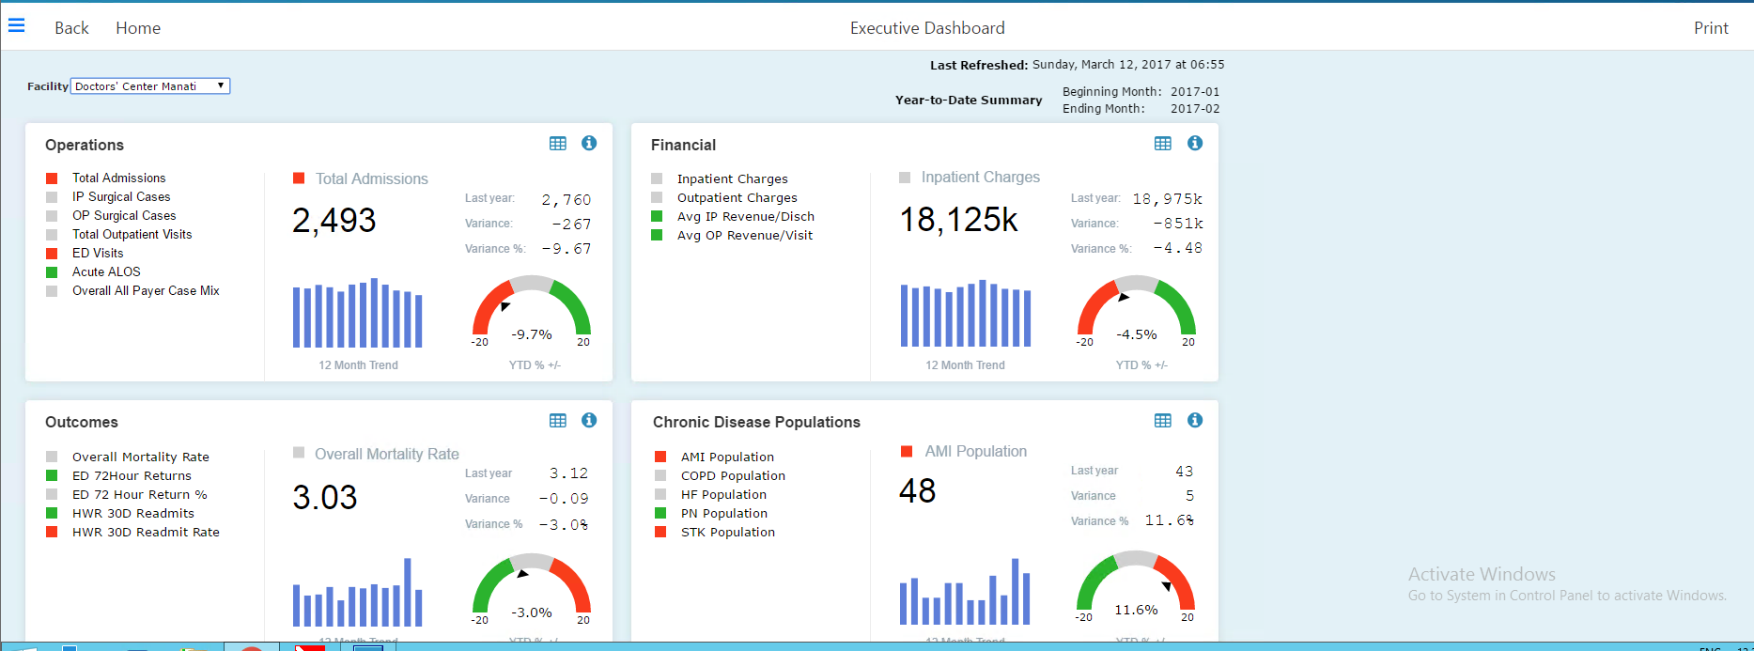
Executive
Dashboard
Home or Back- takes you back to main dashboard screen
Facility- All = System, Hospital A, Hospital B
Date field Options: see begin and end dates to right of field
Calendar- Year to date summary beginning in January
Last refresh date
Dashboard sections- click on a measure beside the color-coded box to change view within that section only
Measure analysis icon- detailed information associated with selected measure, perform ad hoc analysis
Info Icon- to see measure overview definition, trended data and graph
Print Icon - Print
1
7
2
5
3
6
4

Slide 8
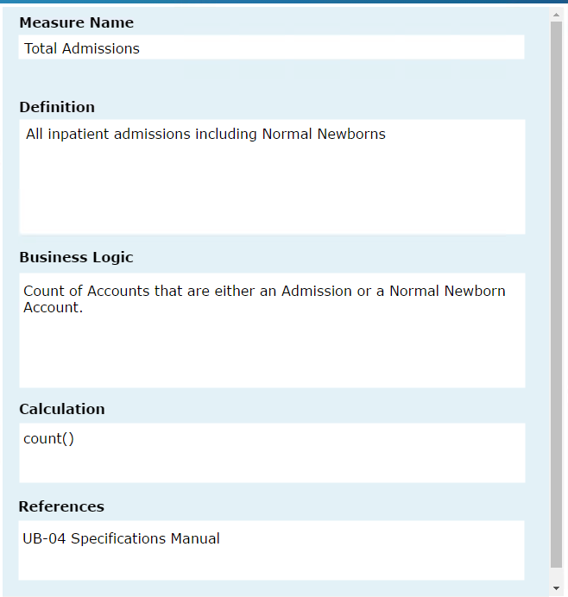
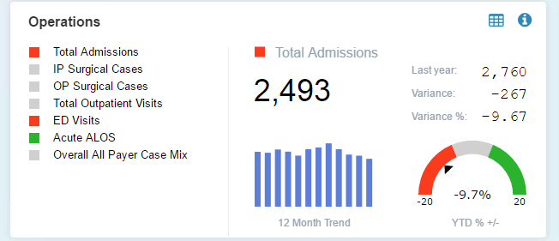
Executive- Operations Section
Measure analysis icon- detailed information associated with selected measure, perform ad hoc analysis
Info Icon- to see measure overview definition, trended data and graph

Slide 9
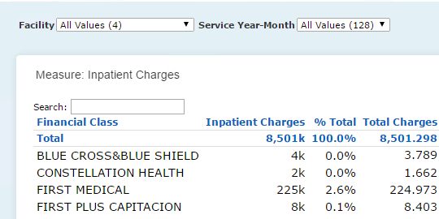
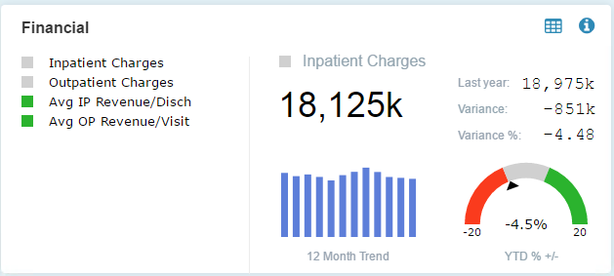
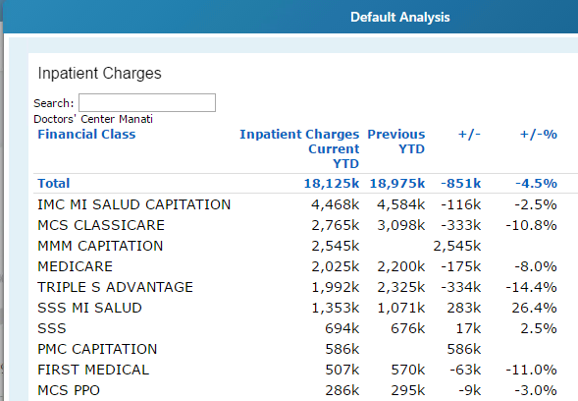
Executive Dashboard
Standard Measure Analysis allows for deeper diving but does not maintain period to period comparison – Advantage – allows for more custom summary fields
Left click on any value (number or graphical)to launch the default analysis-- NOTE: Default analysis maintains period to period comparison

Slide 10
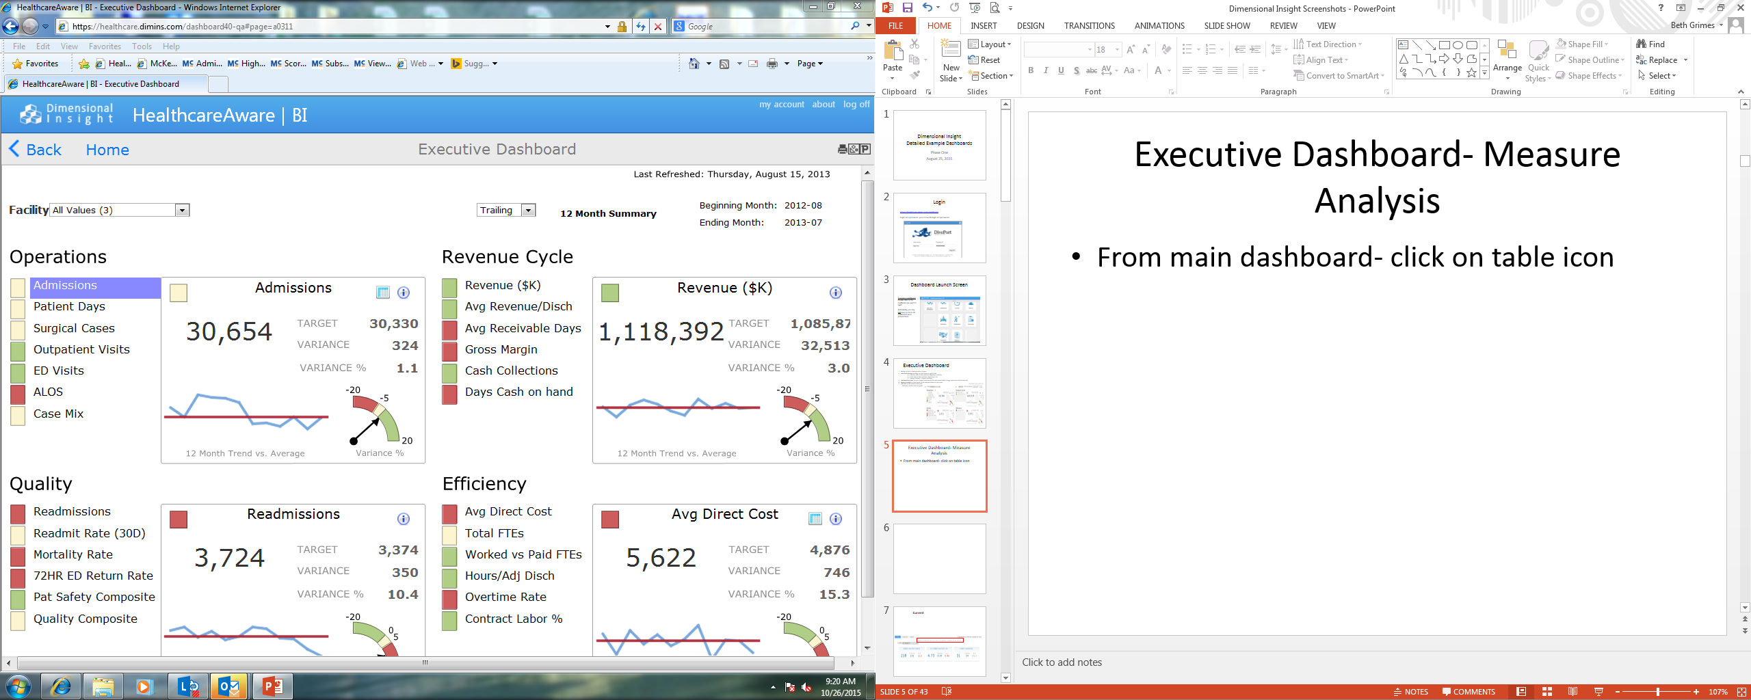
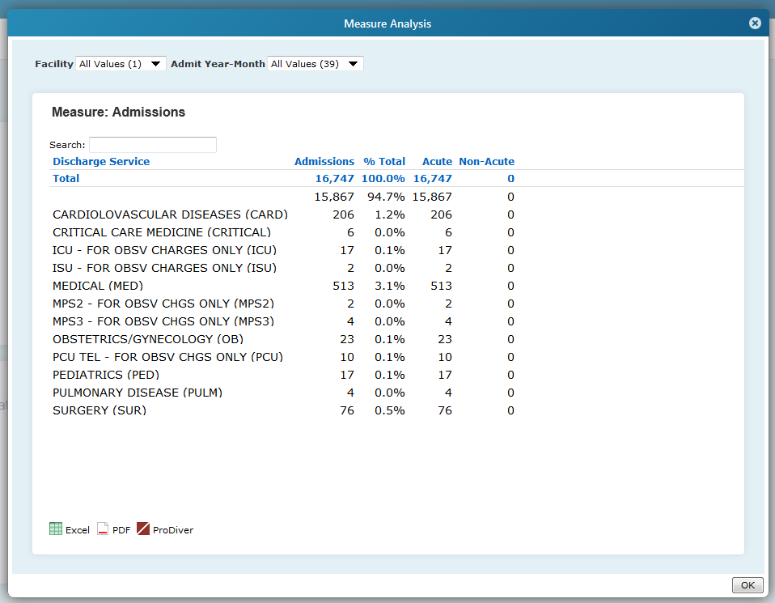
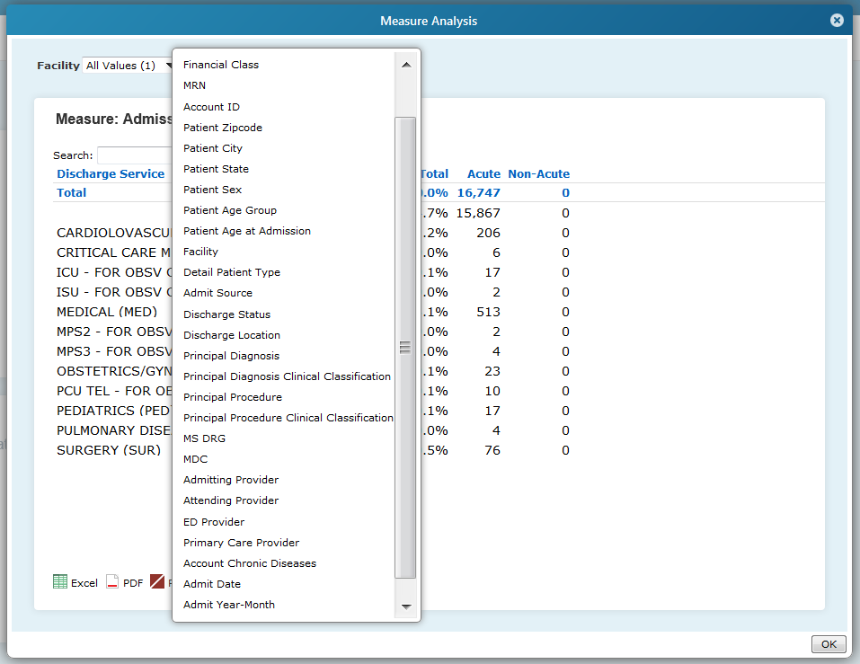
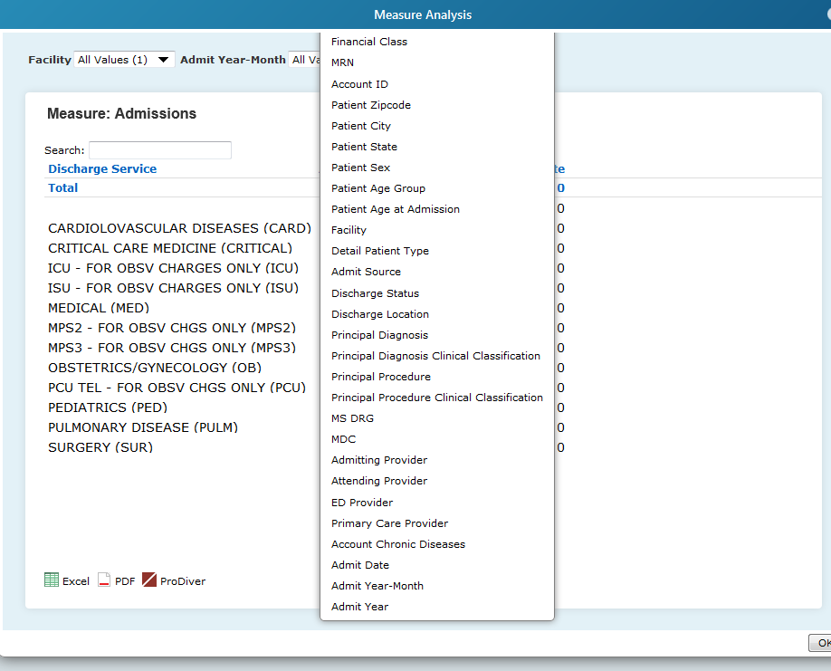
Executive- Measure Analysis
To access click on table icon in top right corner of dashboard section
Filter or Dive down options: Left click on any
Facility or Admit Year-month drop down
Discharge service- click to see measure menu- click any measure to change starting point for Dive down
Service- select measure in current list to see menu for additional Dive down measures-detailed data displayed for selected measure from menu
a
b
c
Can export from screen into excel or PDF or open in ProDiver

Slide 11
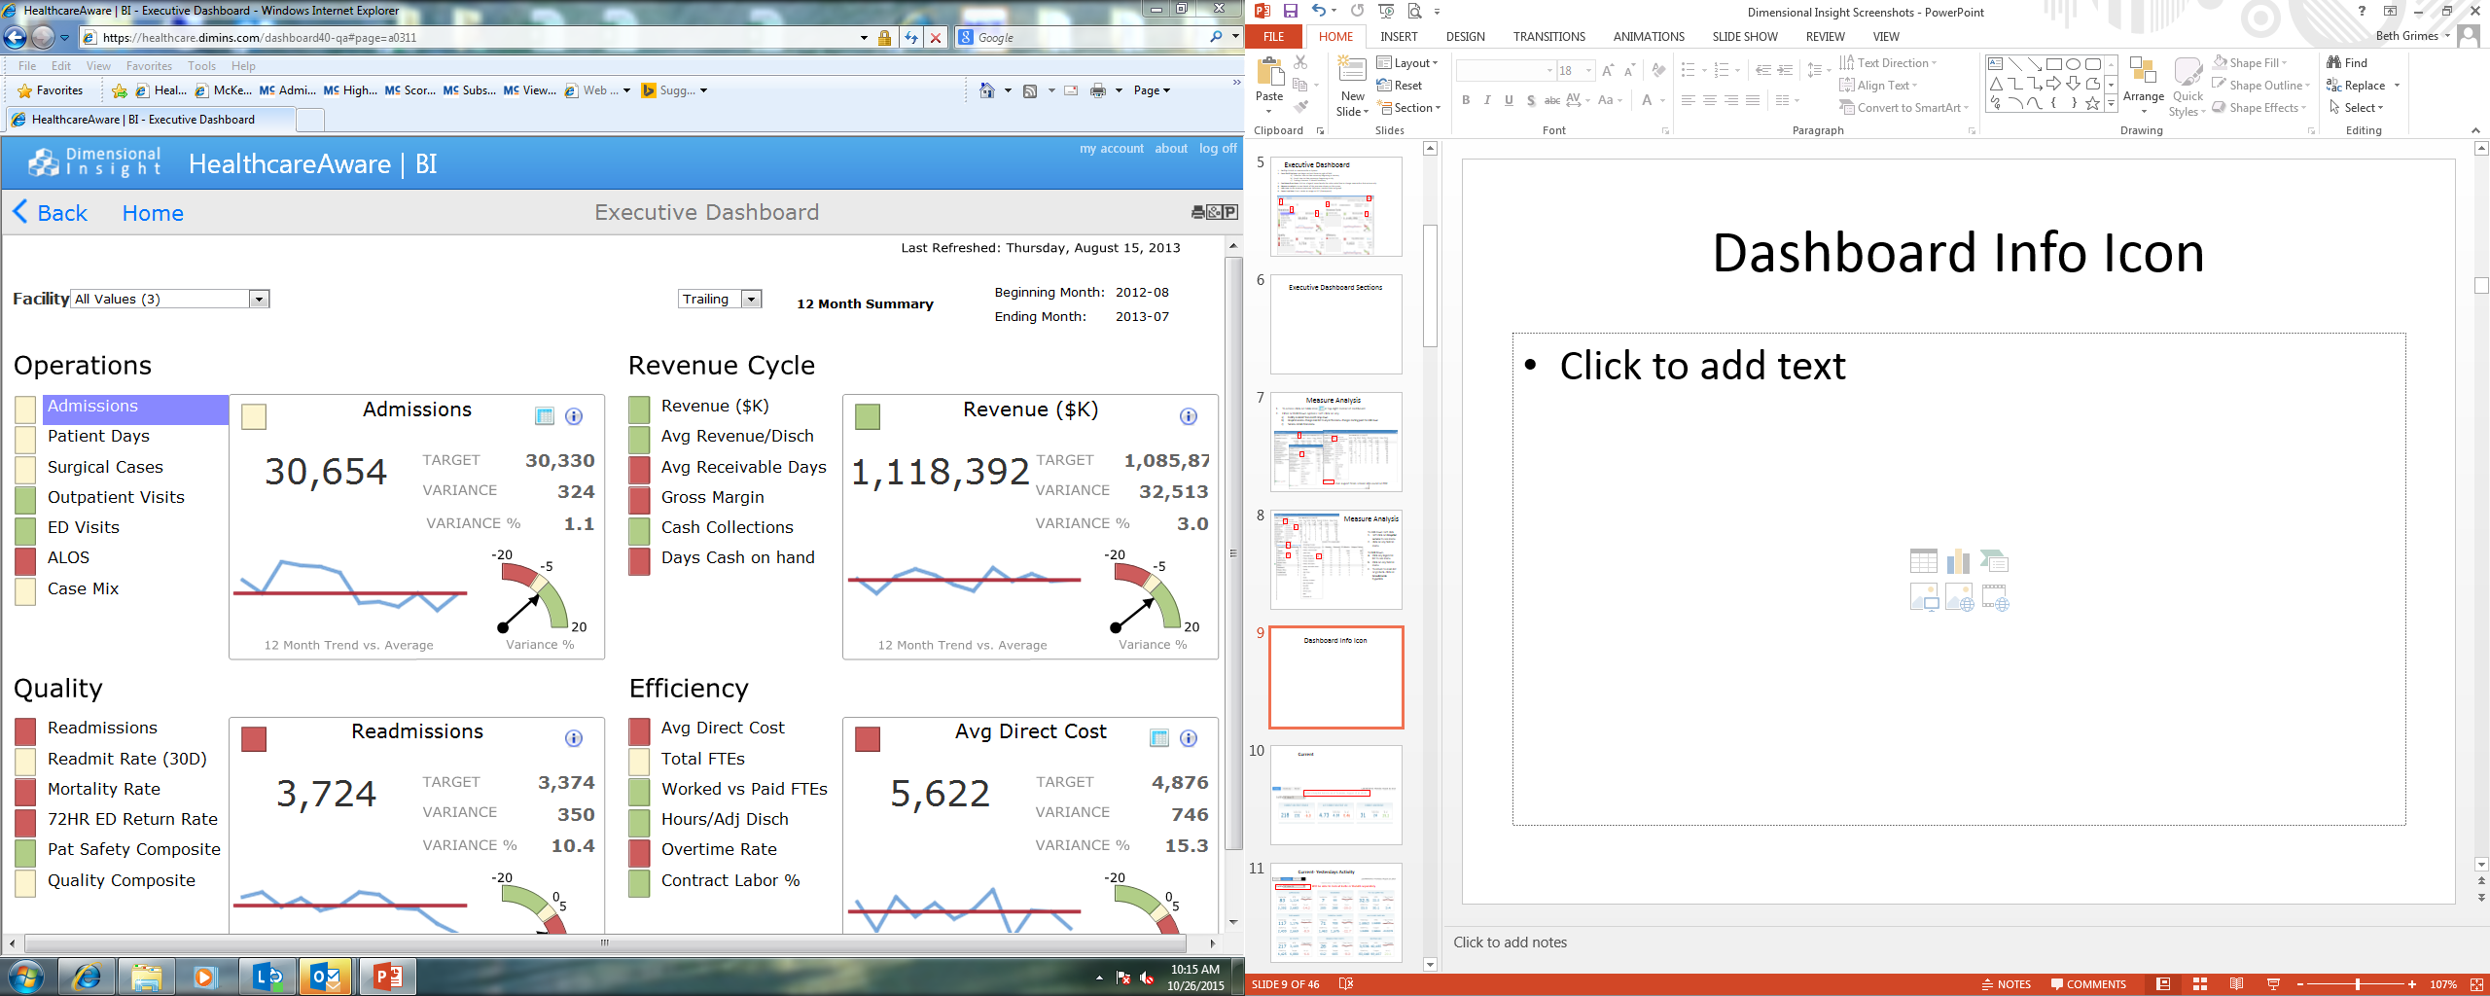
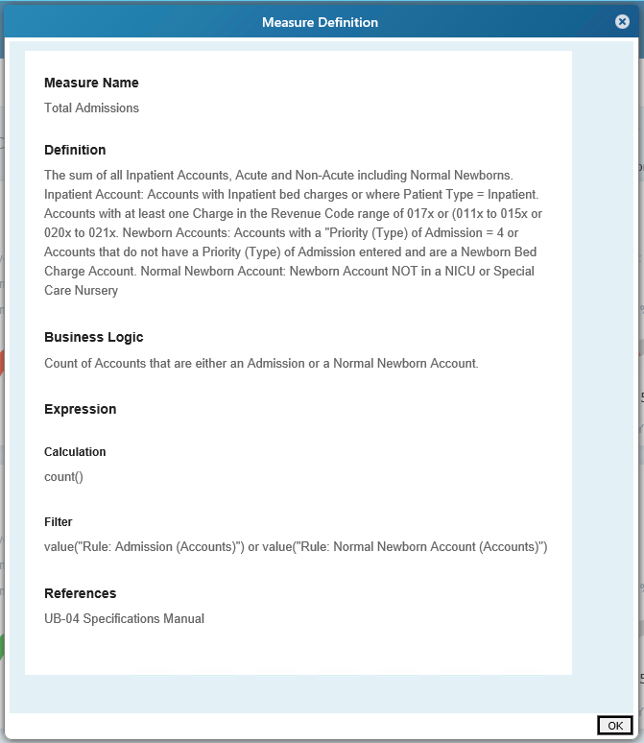
Executive- Measure Definition- Info Icon
To access the measure definition click on Info Icon n top right corner of dashboard corner to get a detailed definition of the measure.

Slide 12
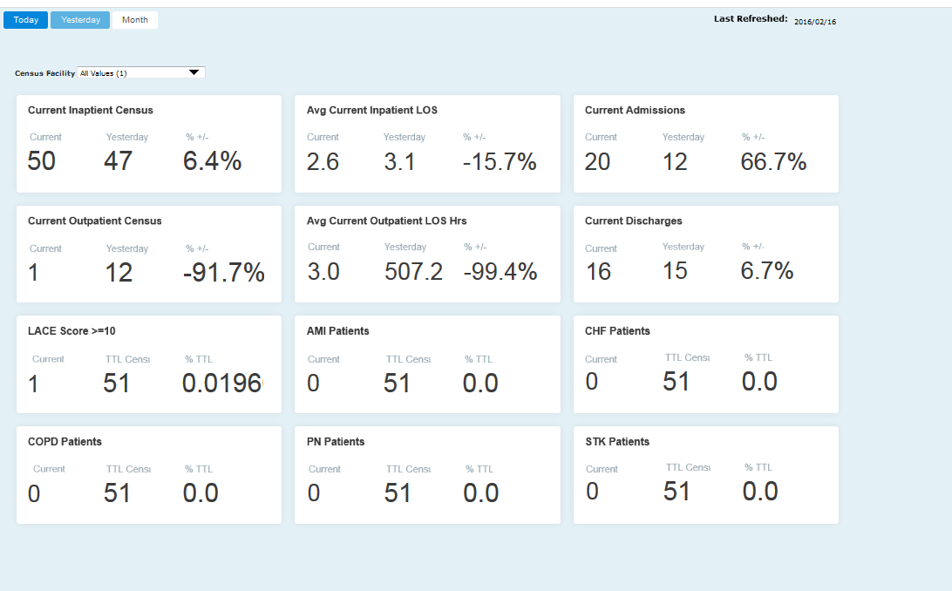
Current- Today Tab
Hourly summary of In-house Census patient counts, LOS and cumulative admit/discharge activityfor the current day
Today Tab – provides insight into “current census” as of latest hour. Identifies patients at risk for readmission based on LACE scores, Identifies patients with history of chronic diseases as identified by past medical history of diagnoses for HF, PN, Stroke, COPD and AMI

Slide 13
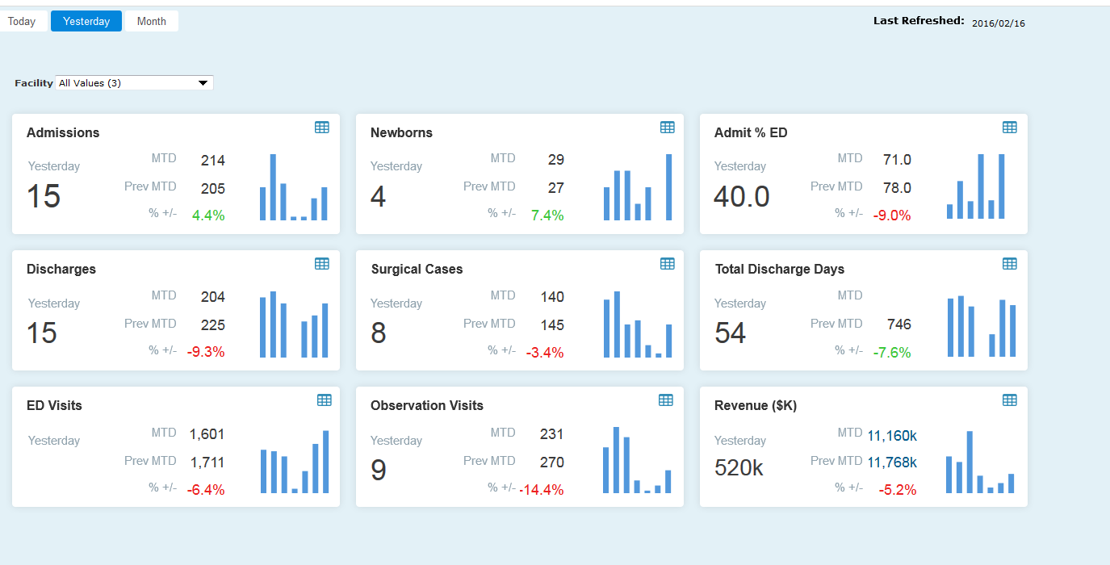
Current- Yesterday Tab
The focus of this dashboard will be to provide a high level view of Activity from the previous day by facility
Left click on any value to launch the default analysis

Slide 14
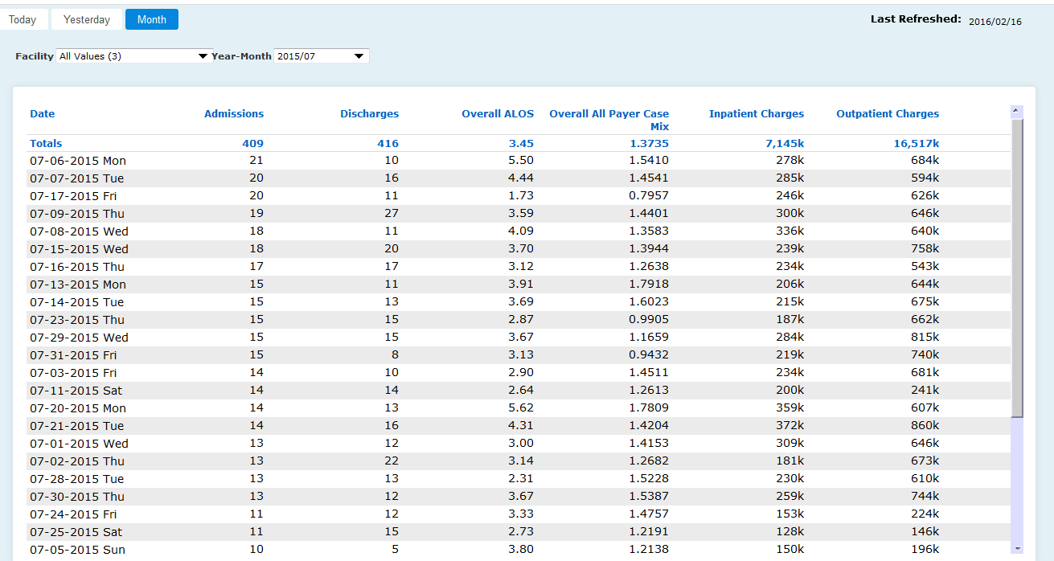
Current- Month Tab
Select Month to view
Left click any column header to re-sort data

Slide 15
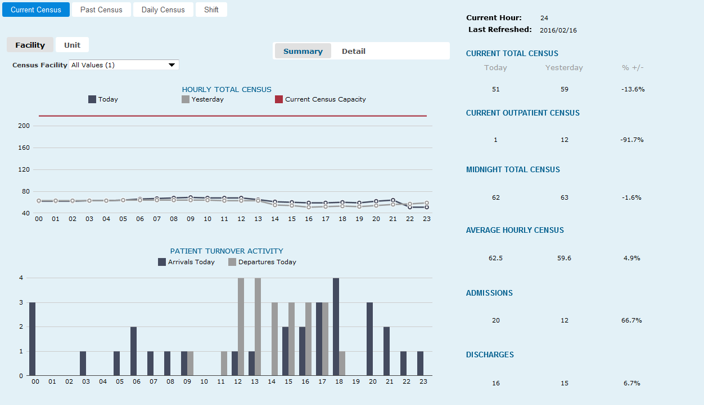
Census- Current Census Tab- System Summary
Additional Views
Left click on any value to launch patient detail

Slide 16
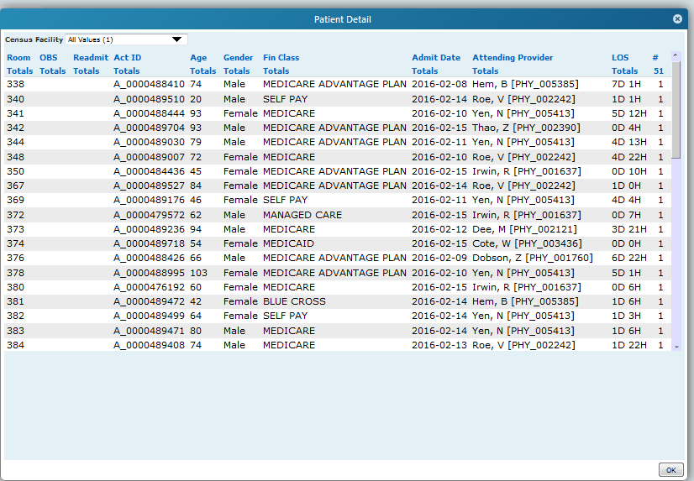
Census- Current Census Tab- Patient Detail

Slide 17
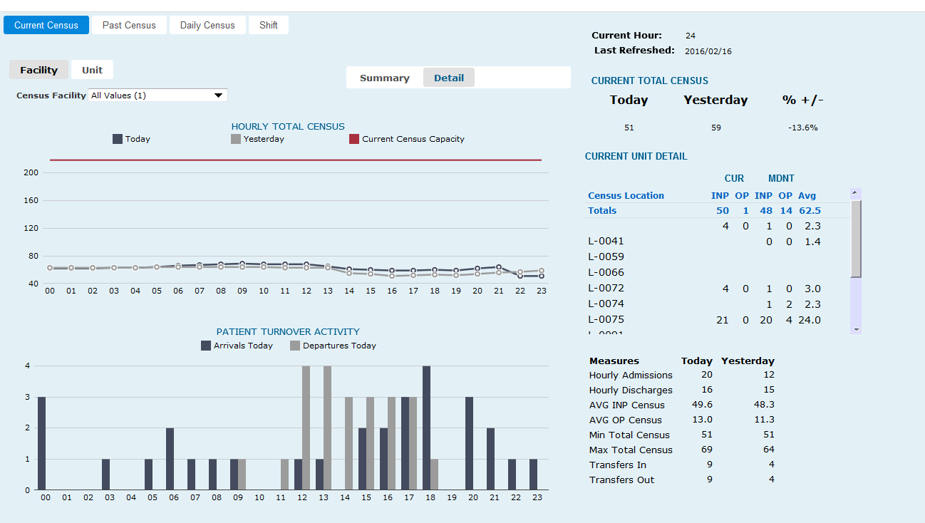
Census- Current Census Tab Detail Page
Additional Views
Within Facility

Slide 18
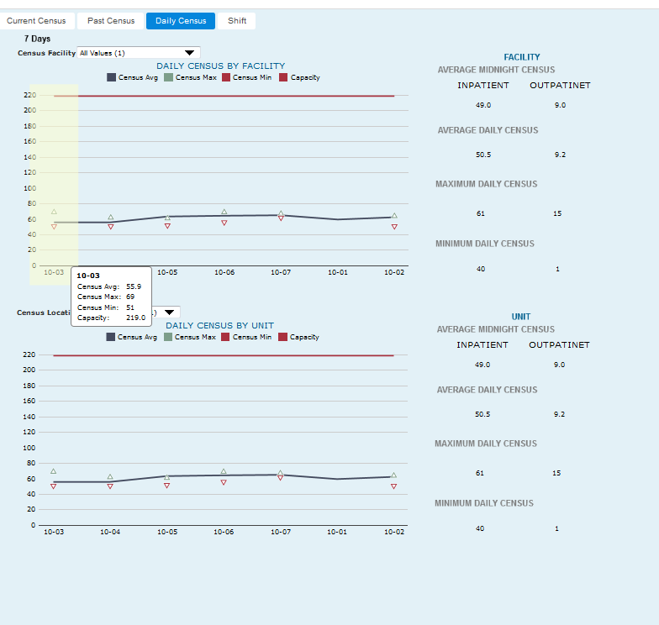
Census- Daily Census Tab
Provides last 7 day trend for census.

Slide 19
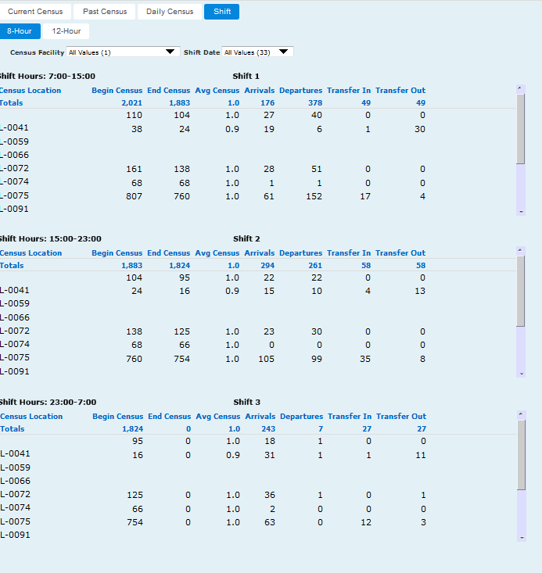
Census- Shift Census Tab
Provides the ability to view census activity by date by shift.

Slide 20
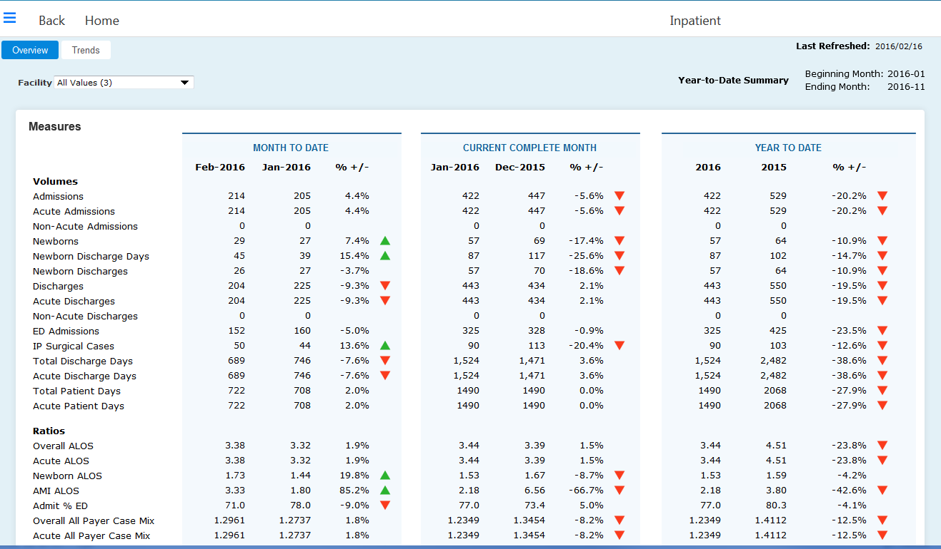
Inpatient Dashboard- Overview Tab- Periods
Calendar or Fiscal Year
Left click a measure to see the Measure Description
Left click a number to open a default analysis portlet

Slide 21
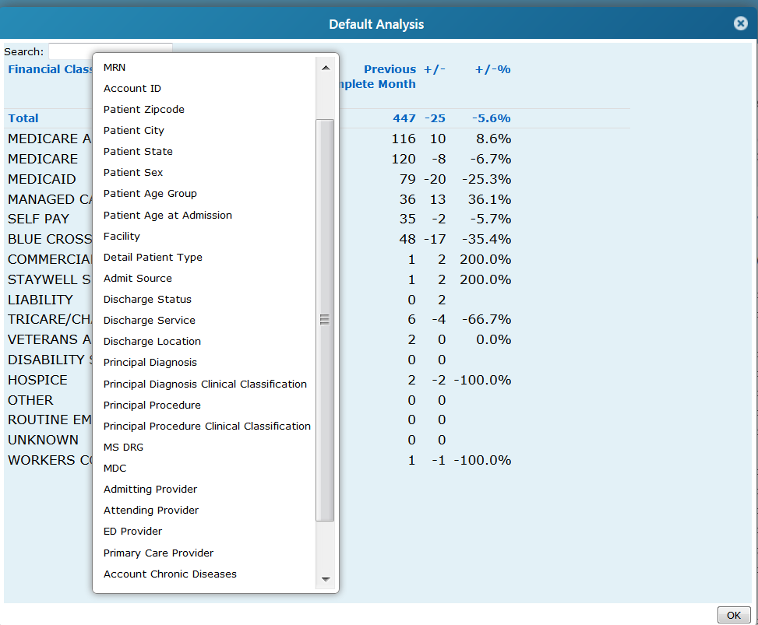
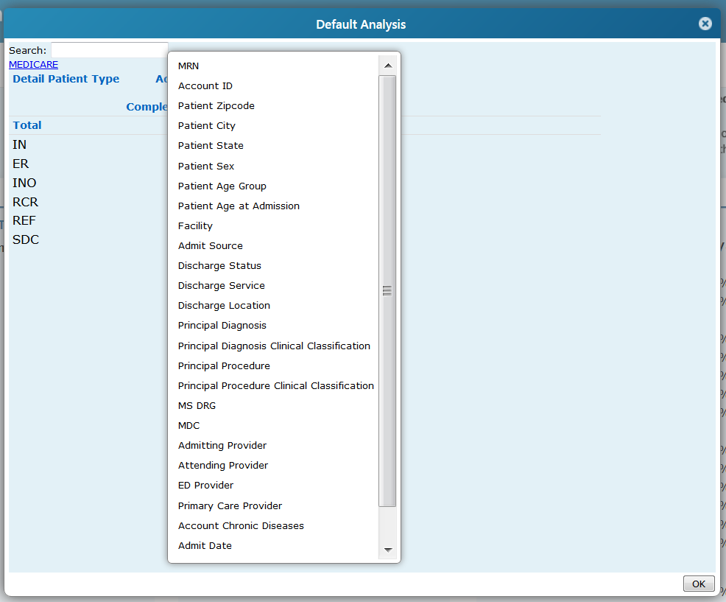
Inpatients- Overview Tab- Default Analysis
1
2
To dive down to detailed data: Left click
left click on Financial Class to see menu for additional measures
click on any measure in menu
To Dive Down-
Select measure in list to see menu
Click on any measure in menu
To return to main list or go back- click on breadcrumb hyperlink
C
A
B

Slide 22
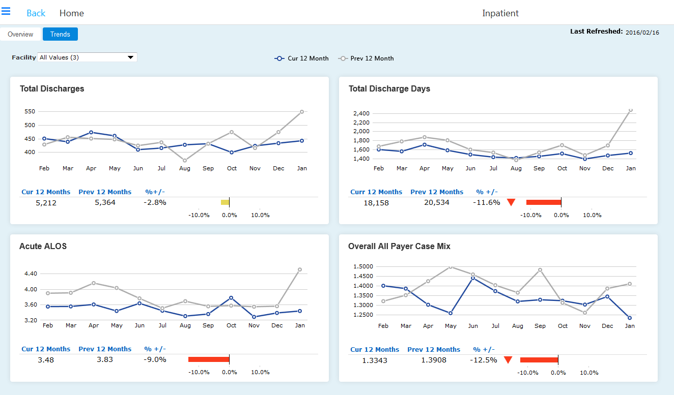
Inpatient
Trends Tab-
Periods
Displays current 12 months compared to Previous 12 months
Left click on any data point to launch a default analysis portlet

Slide 23
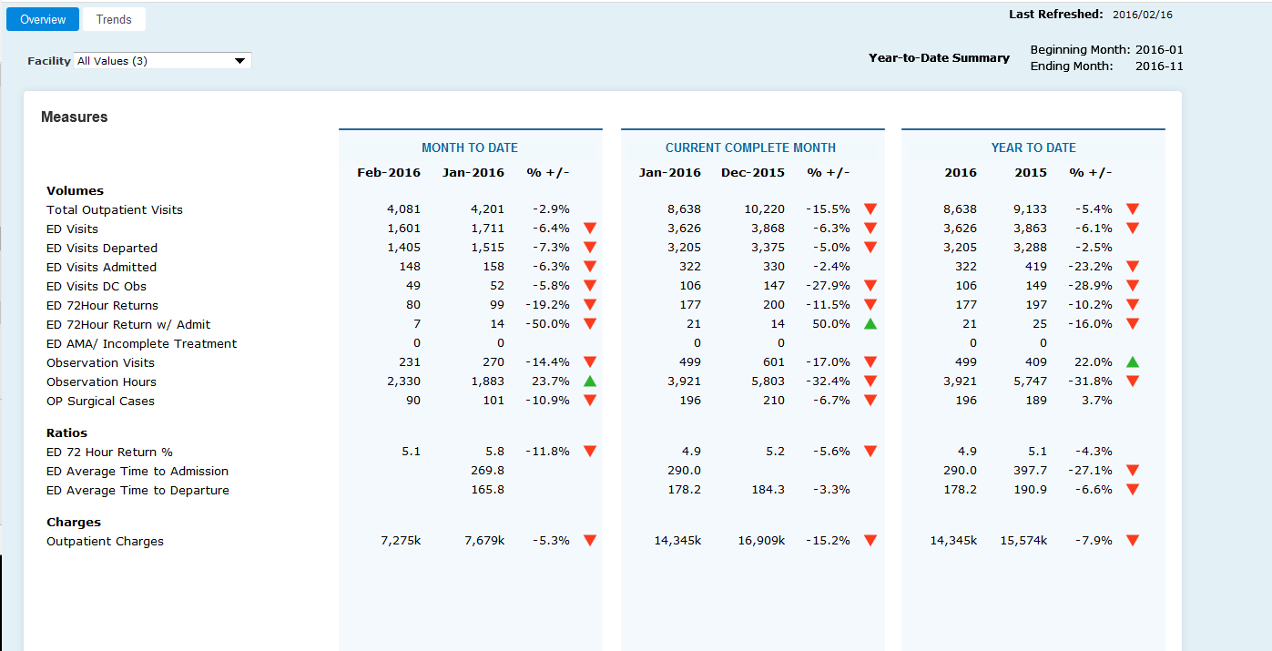
Outpatient- Overview Tab
Behaves the same as the IP Overview Page

Slide 24
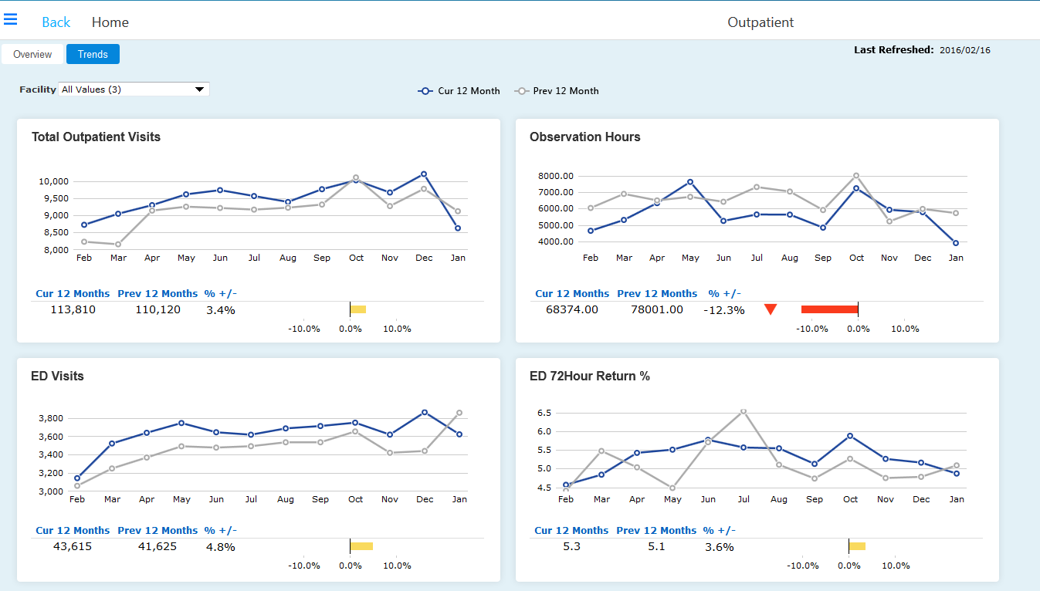
Outpatient
Trends-
12 month
Periods
Displays current 12 months to Previous 12 months
Left click on any data point to launch an analysis portlet

Slide 25
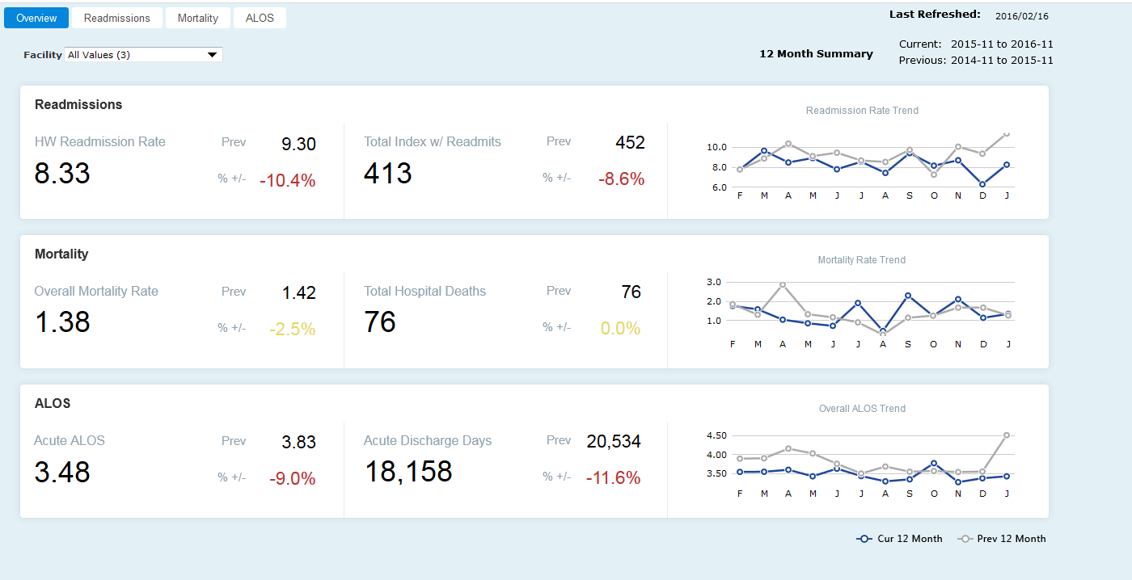
Outcomes- Overview Tab
Provides a 12 month summary of Readmissions, Mortality and Acute ALOS on Overview Page. Additional Pages are available for specific analysis of each measure
Left click on any data point to launch an analysis portlet

Slide 26
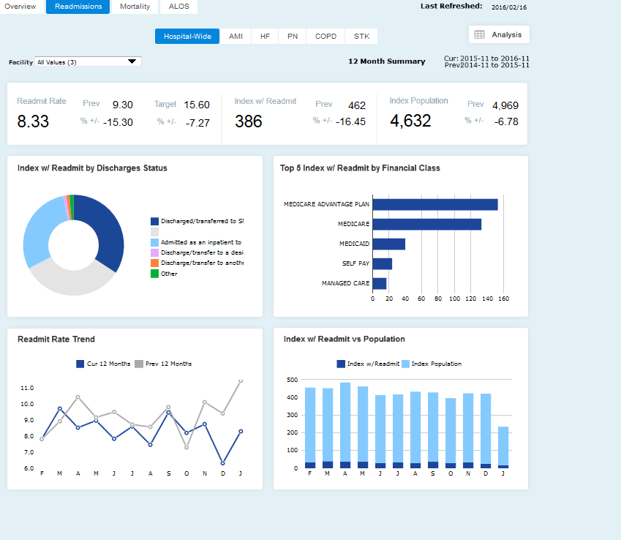
Outcomes- Readmissions Tab
Hospital Wide
Left click on any data point to launch an analysis portlet

Slide 27
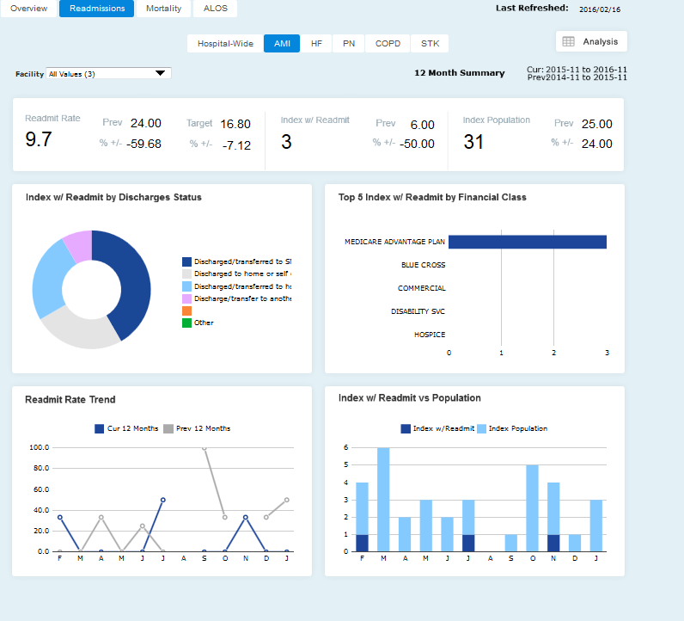
Outcomes Readmissions
Tab-
Disease Specific
Left click on any data point to launch an analysis portlet

Slide 28
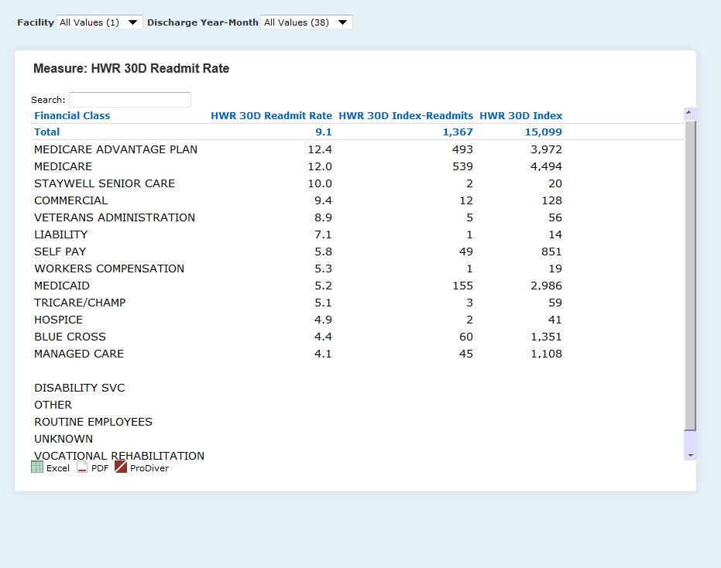
Outcomes- Readmissions Tab- Analyze Icon

Slide 29
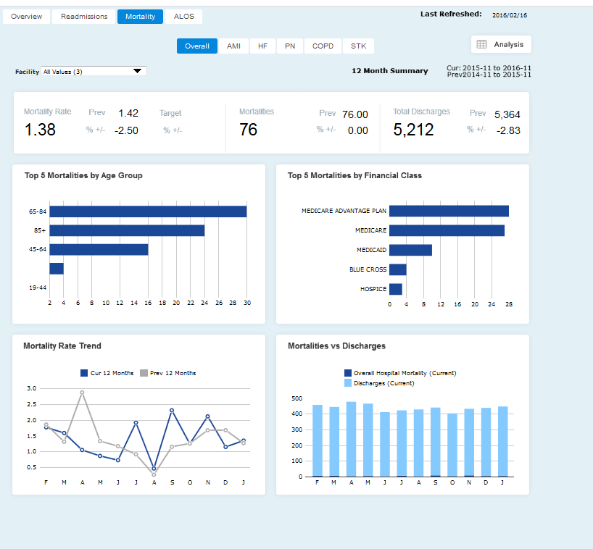
Outcomes - Mortality Tab
Left click on any data point to launch an analysis portlet

Slide 30
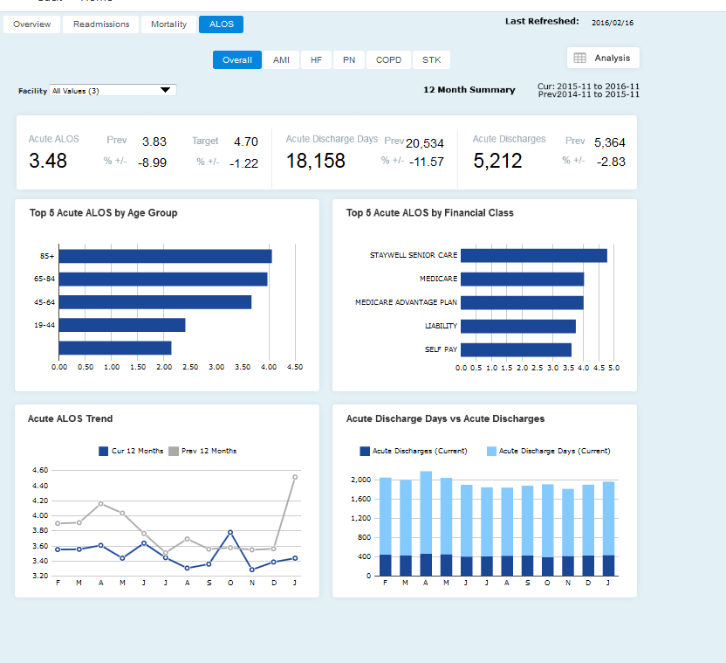
Outcomes - ALOS Tab
Left click on any data point to launch an analysis portlet

Slide 31
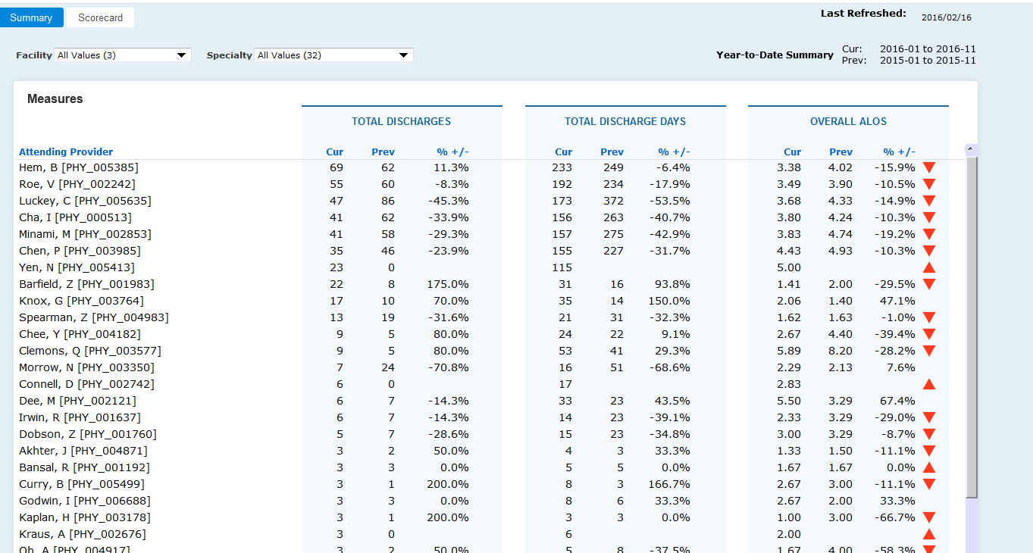
Physicians- Summary Tab
Click any row measure to open individual Physician scorecard

Slide 32
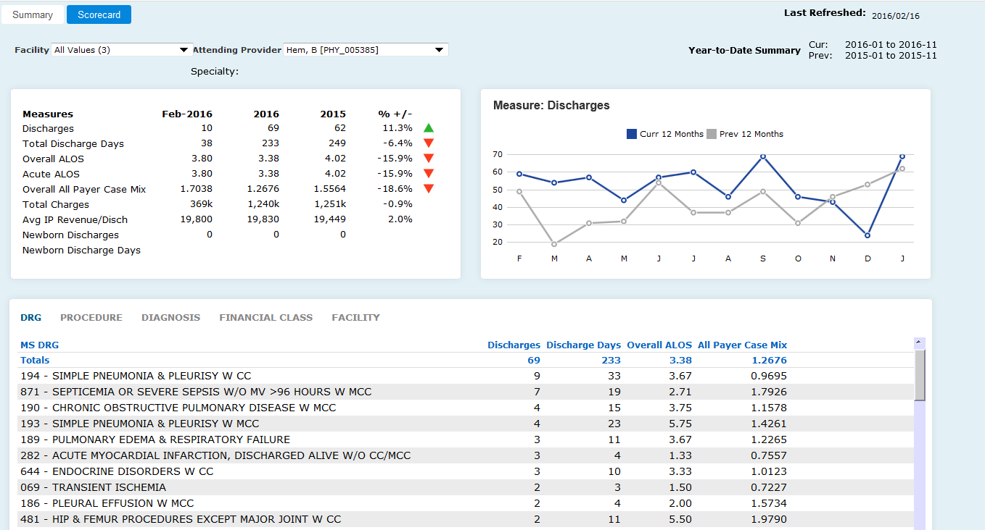
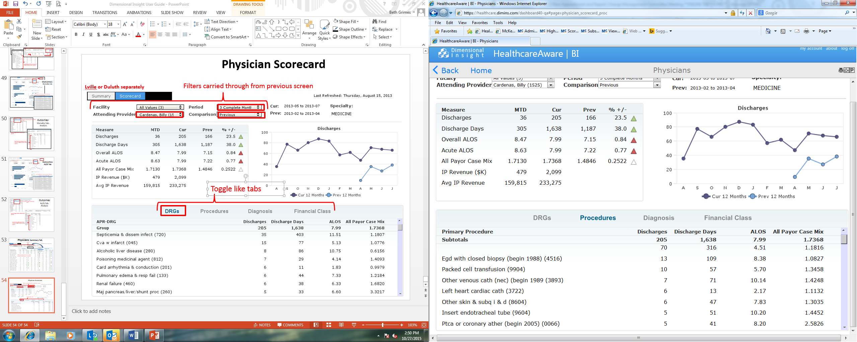
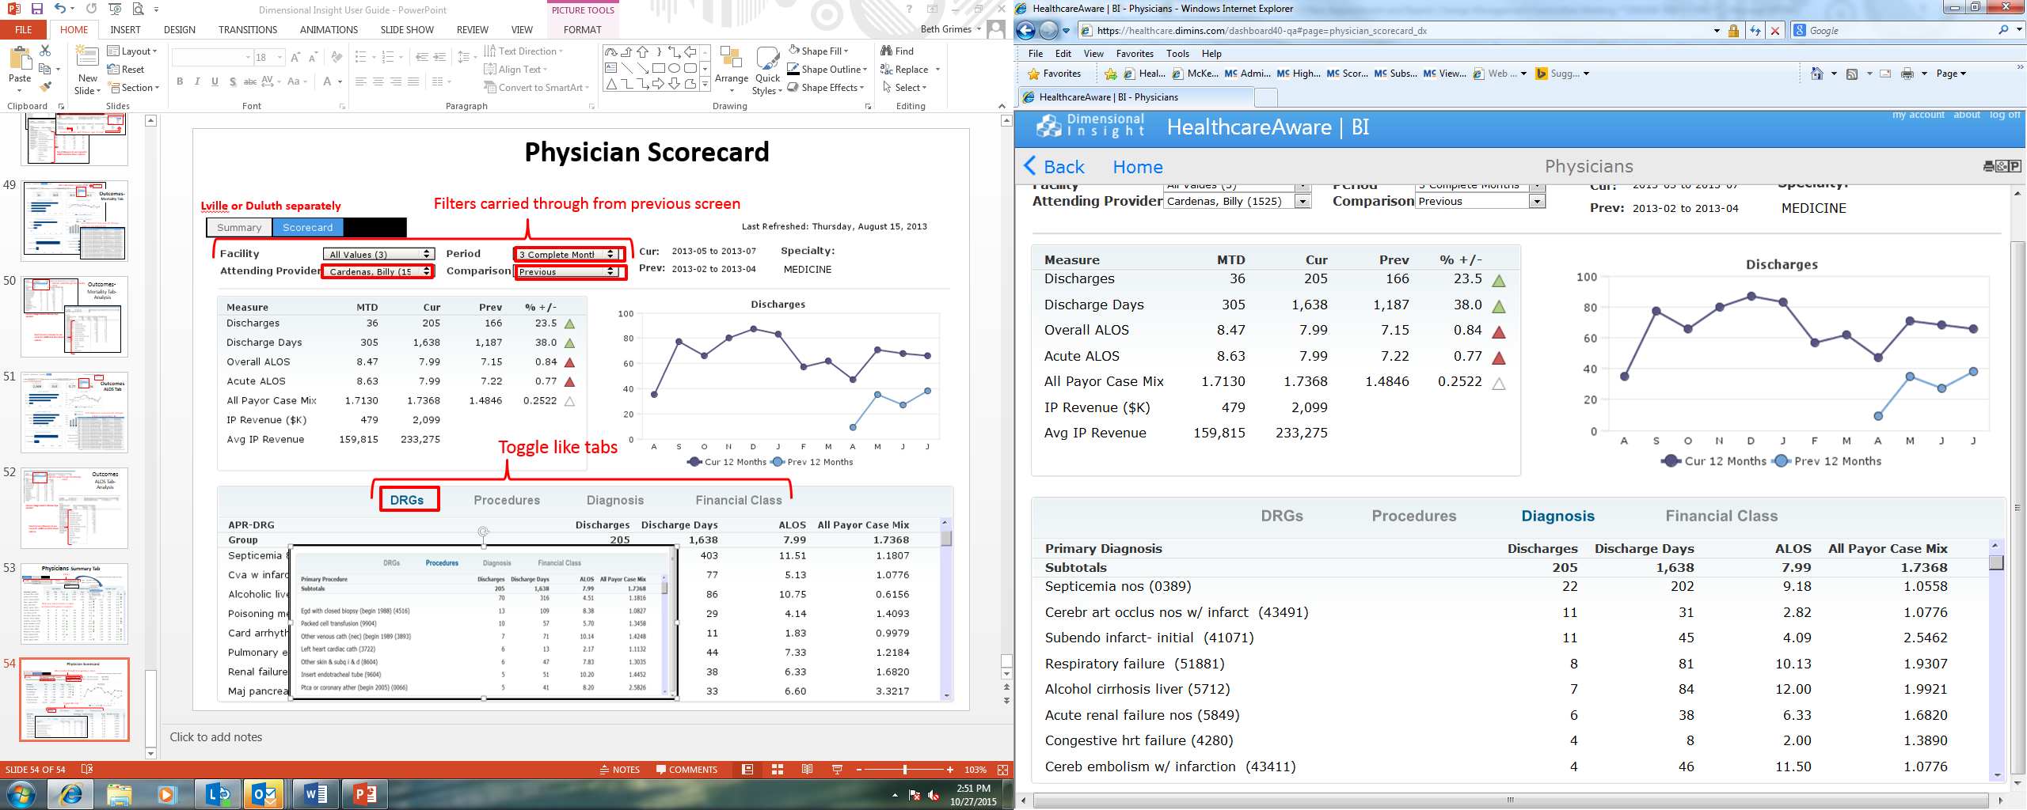
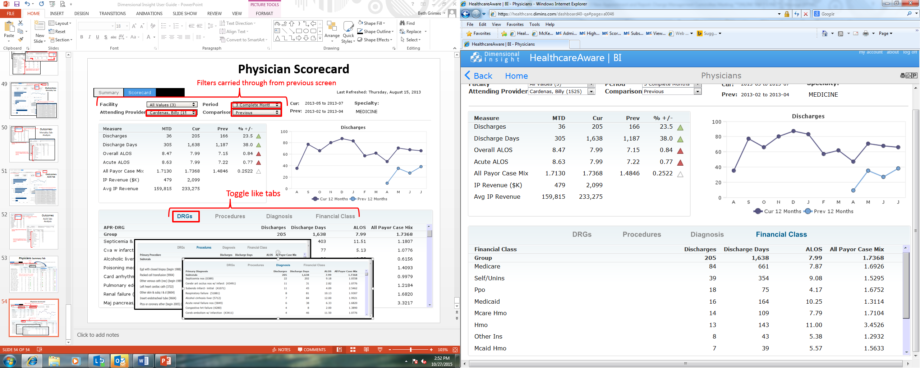
Physician- Scorecard
Filters carried through from previous screen
Click to toggle like tabs

Slide 33
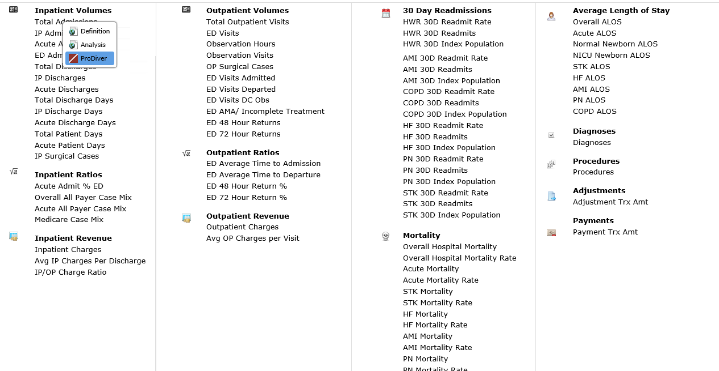
Measure Dictionary
This Tab allows you to “shortcut” to all the measures on the Framework Dashboard and start analysis directly from this page by simply clicking on a measure to evoke a measure analysis page
From this page you can go directly into ProDiver (desktop client) to do even more in-depth analysis

Slide 34
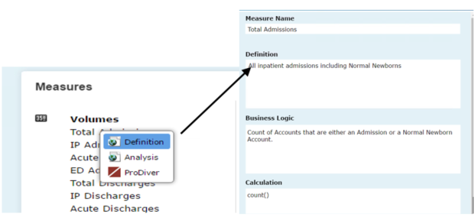
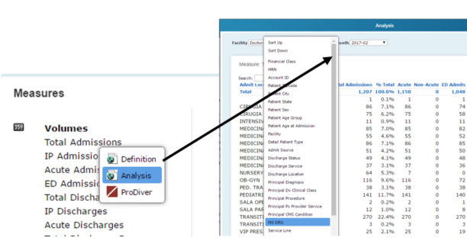
Measure Dictionary Cont.
On the Measure master page, the end use can select the Definition, Analysis or if they have ProDiver access, they can go launch ProDiver from the Dashboard

Slide 35
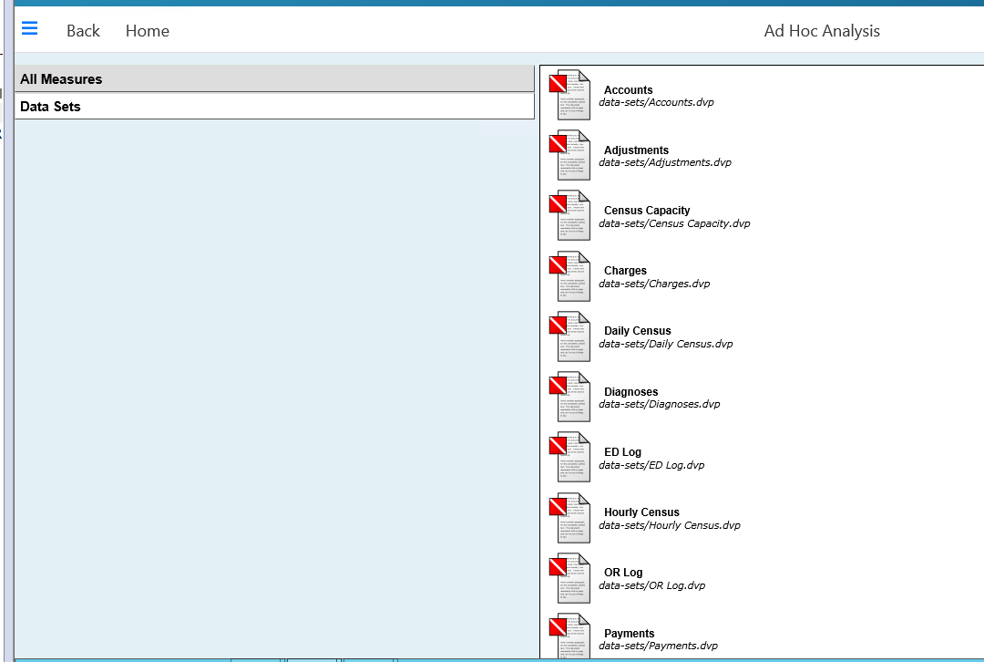
Ad Hoc Analysis
The Ad Hoc Analysis page provides access all measures and data sets created by the Measure Factory to Users who have access to the ProDiver Desktop Client.

